Slide 1
Chapter 7: Distribution Derived From Normal Distribution
Textbook: Ahmad Daryanto, Introduction to Quantitative Research Methods for Marketing With SPSS and R: Tools and Techniques, Routledge. 2024

Slide 2
Learning Objectives
Know some distributions derived from normal distribution T, F, and Chi-squared distribution.
Know how to use SPSS macro and R to calculate areas under a non-normal distribution curve.

Slide 3
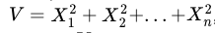
Chi-Squared Distribution
Chi-squared distribution commonly represented by this Greek’s symbol 𝜒2 appears later when we discussed proportion test and Crosstabs.
It is a continuous distribution. The shape of the distribution is determined by one parameter called its degrees of freedom (df).
A Chi-squared distribution with n degrees of freedom can be constructed from n standard normal random variables.
then V follows a Chi-squared distribution with n degrees of freedom

Slide 4
Degrees of Freedom
The meaning of the degrees of freedom can be explained as follows: Suppose that I want you to mention 5 numbers that you like. However, the mean of the 5 numbers must be 10. While you can arbitrarily choose the first four numbers, the last number must be fixed to ensure that the mean score is 10. In this example, your degrees of freedom is 4 – you are losing one degree of freedom because the mean score is certain. If you were to mentioned 15 numbers with the mean score is kept at a certain value, then your degrees of freedom is 14. It is obvious that in these two illustrations, your degrees of freedom is equal to N−1, where N is the sample size. Hence, when sample size gets larger, the degrees of freedom also gets larger.

Slide 5
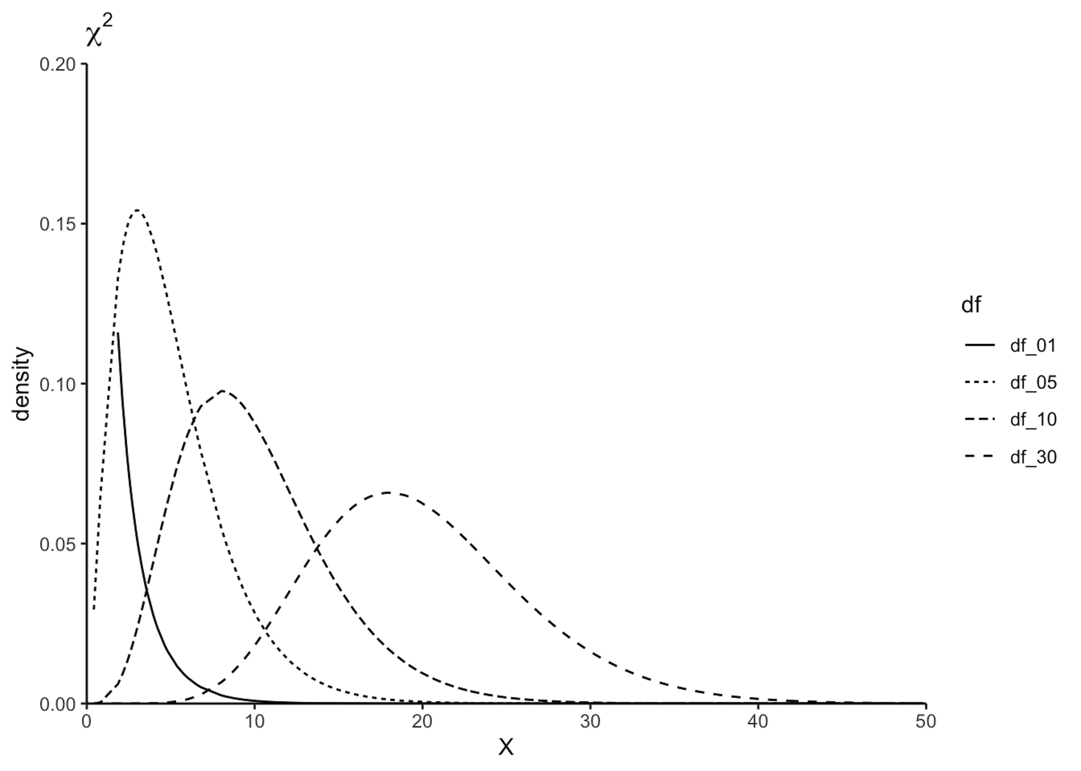
Chi-square distributions with various degrees of freedom

Slide 6
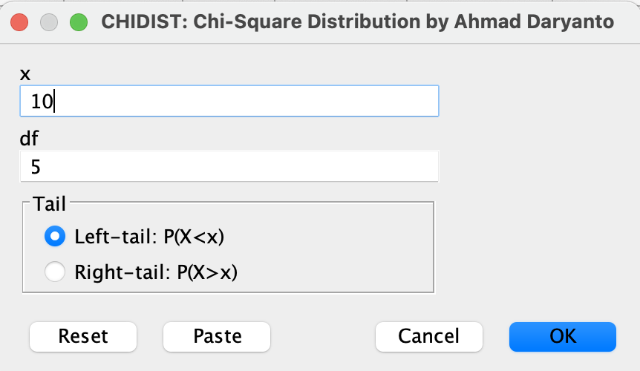
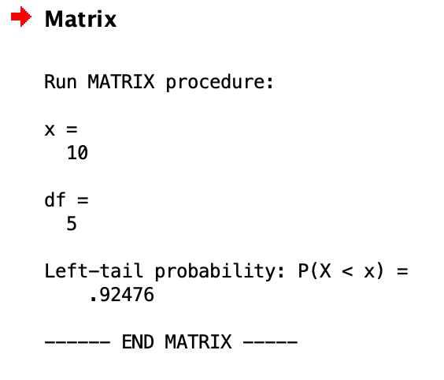
Finding An Area Under The Chi-squared Distribution Curve
Using CHIDIST macro

Slide 7
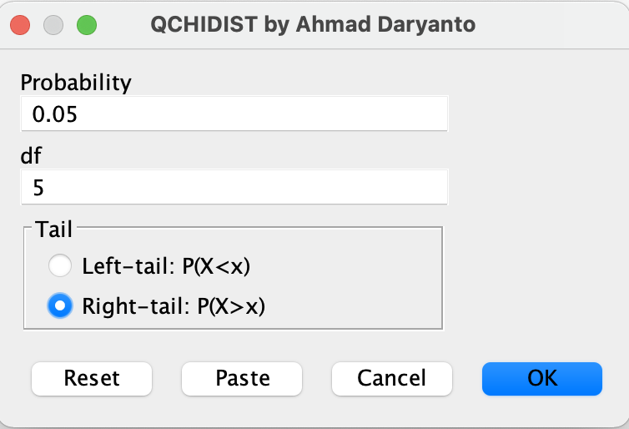
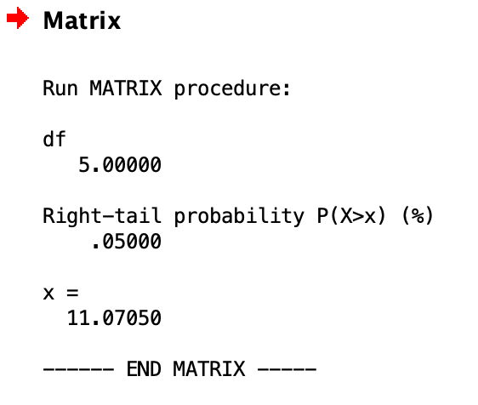
Using QCHIDIST macro

Slide 8
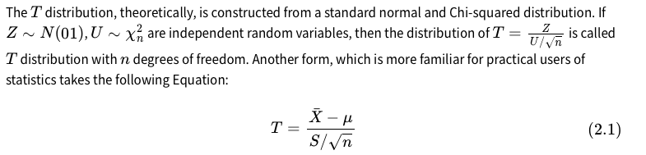
T Distribution
It is a continuous distribution. The shape of the distribution is determined by one parameter called its degrees of freedom (df).

Slide 9
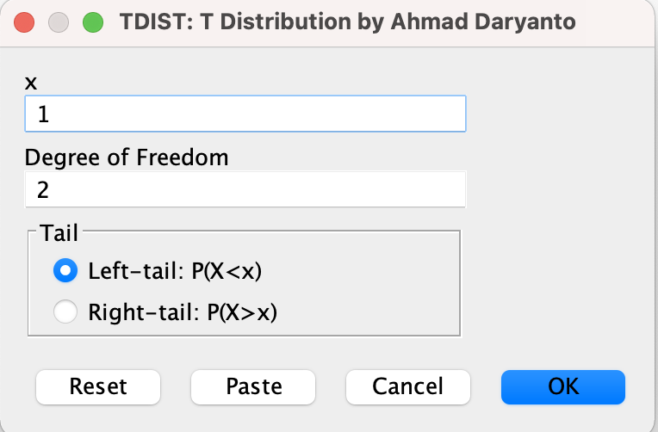
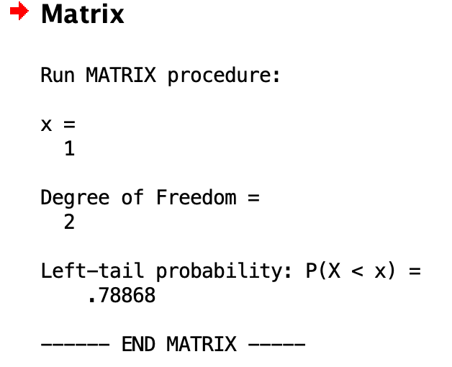
Finding An Area Under The T Distribution Curve
Using TDIST macro

Slide 10
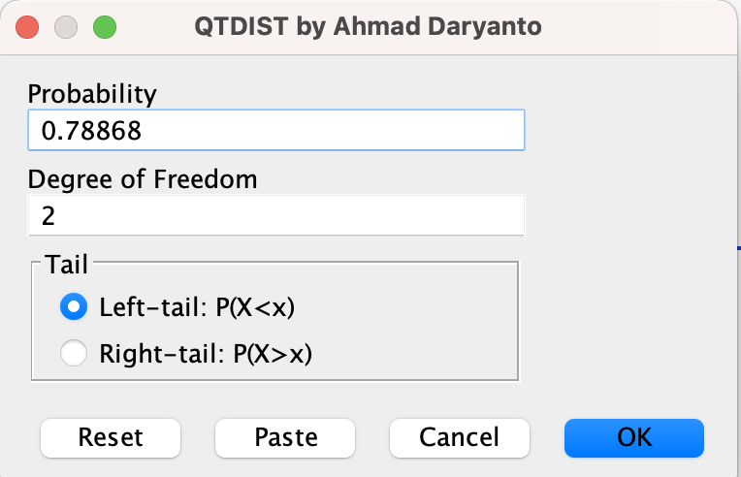
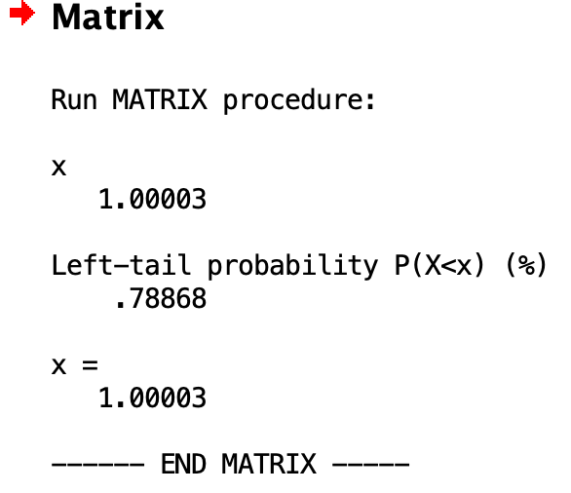
Using QDIST macro

Slide 11
F Distribution
The F distribution appears later when you learn crosstabs and ANOVA. The shape of the distribution is determined by two degrees of freedom.
The F distribution is denoted by F(df1,df2) where df1 and df2 are the first and the second degrees of freedom.
Theoretically, F distribution is constructed from two Chi-squared distributions.

Slide 12
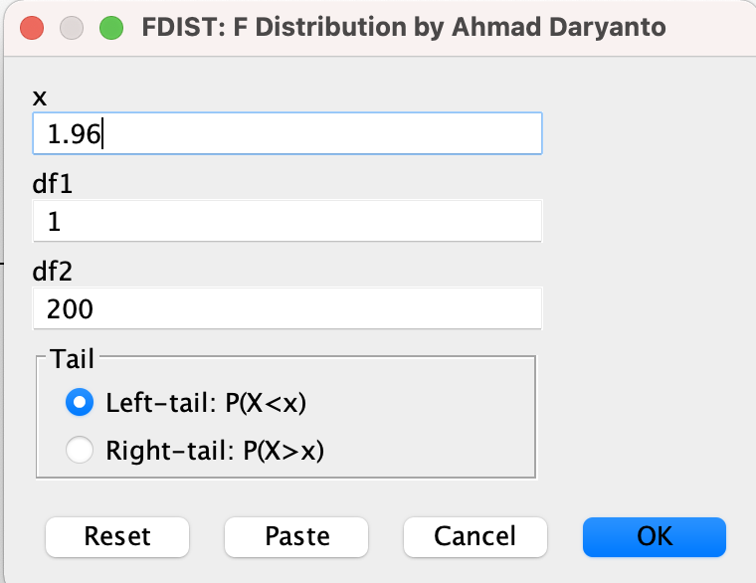
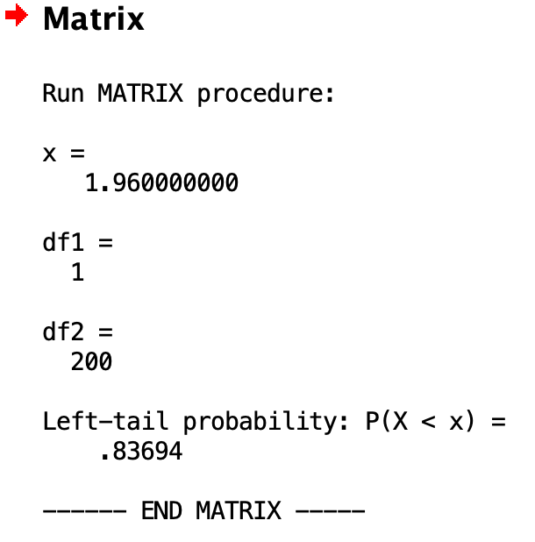
Finding An Area Under The F Distribution Curve
Using FDIST macro

Slide 13
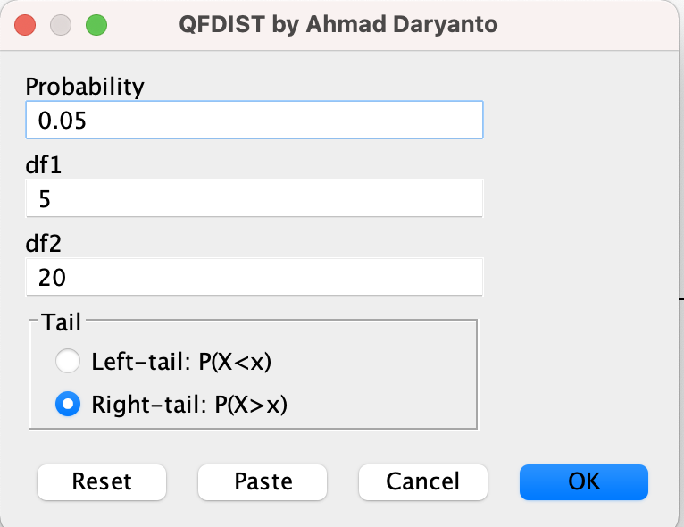
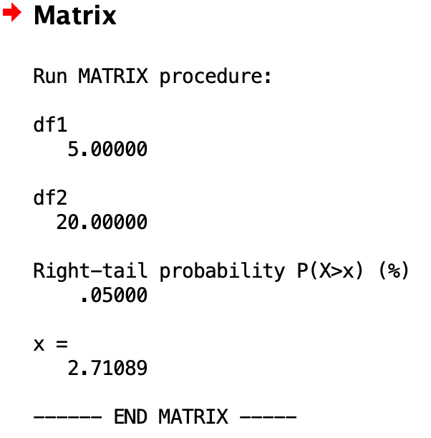
Using QFDIST macro

Slide 15
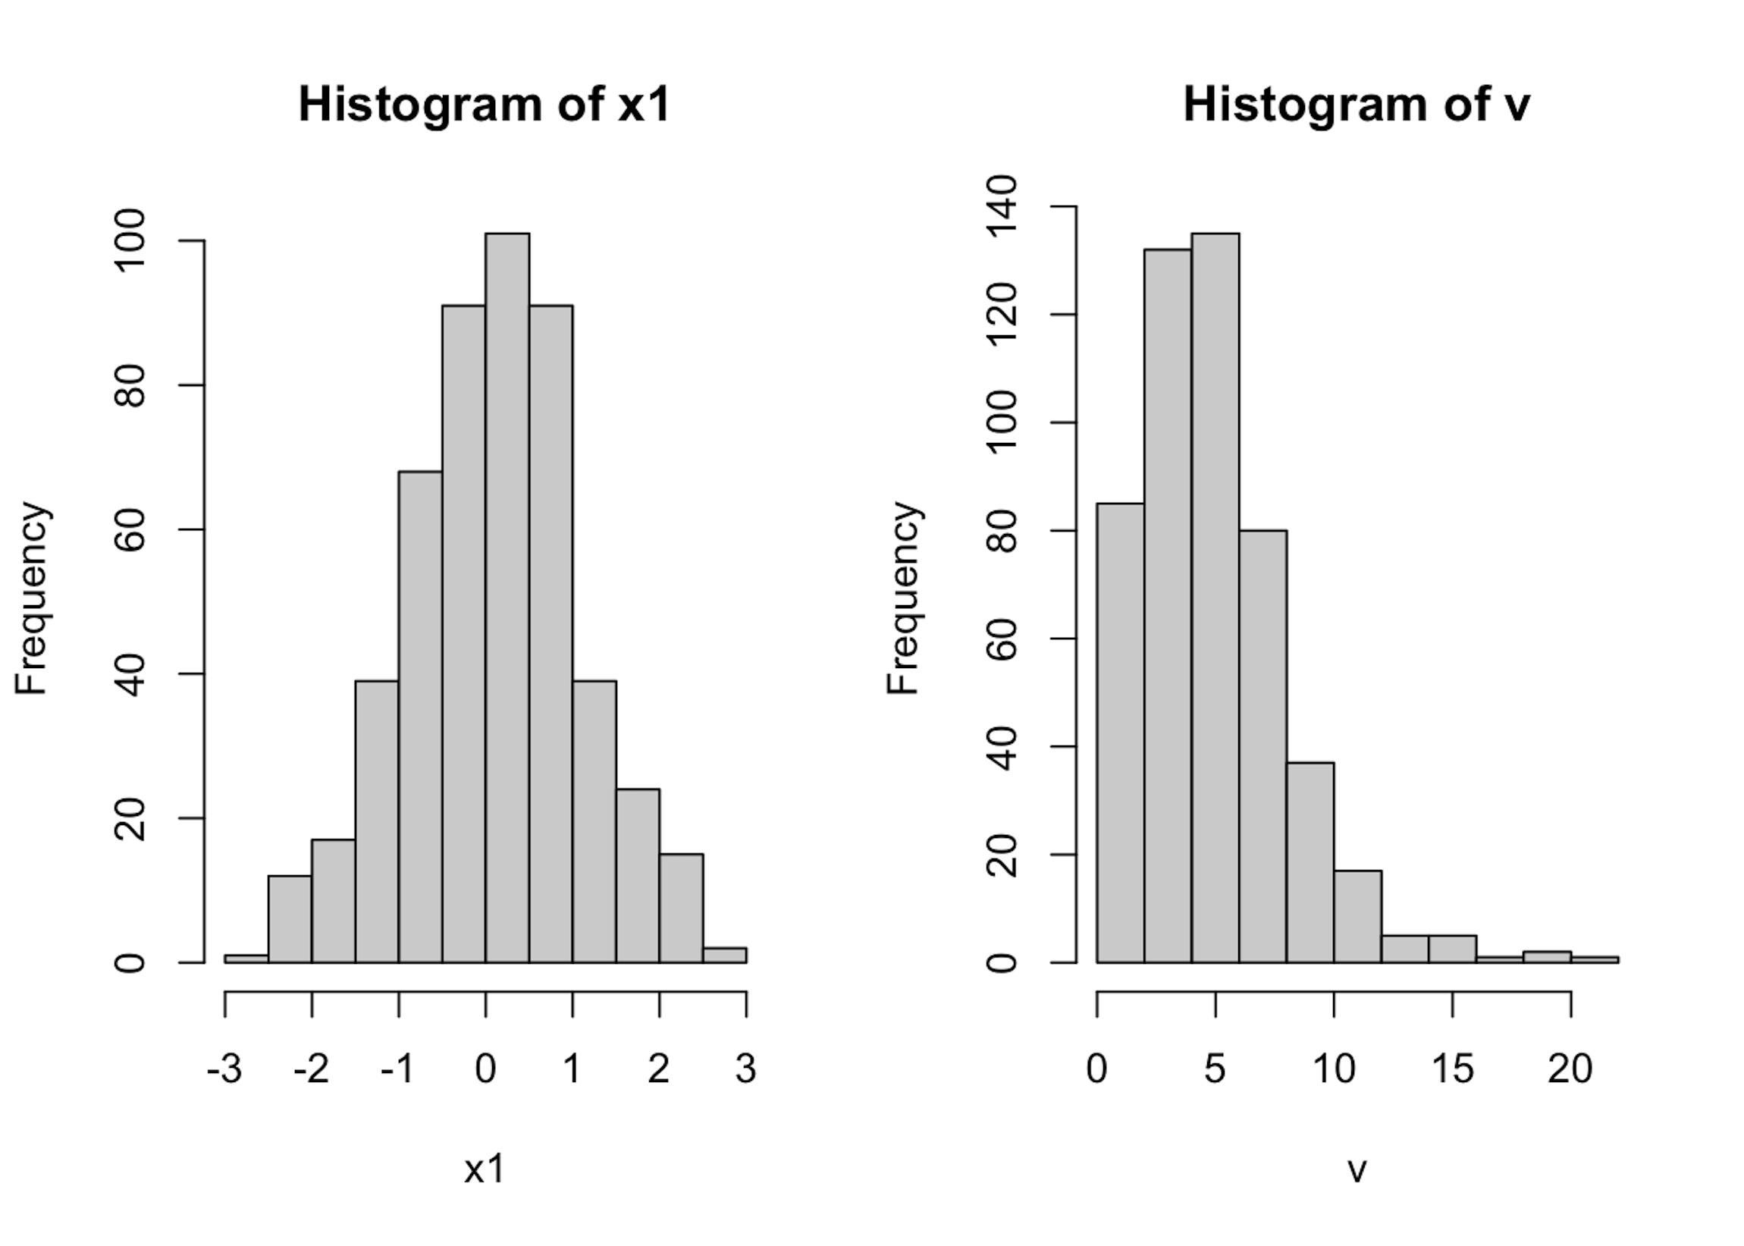
Seeing Is Believing
We have learned that a Chi-squared distribution with n degrees of freedom can be constructed by taking the sum of squares of the standard normal distribution. We could use simulation to prove this.
See the R and SPSS code in the book

